Slide 1

Poop Ninjas
Lyndon-John Lemmers Jeremy Chan Samantha Perez Andrew Tsai
Giampiero Giovingo
By: Group 19

Slide 2

Team Members
Samantha Perez: Front End
Andrew Tsai: Front End
Jeremy Chan: API
Giampiero Giovingo: API
Lyndon-John Lemmers: Database/PM

Slide 3

Technology Used
Digital Ocean (Hosting site for LAMP server)
Bootstrap/JS/JQuery (Front end)
MySQL (Database)
PHP (Scripting language for API)
Name.com for Domain name
ARC and SwaggerHub for API
Github
Discord for Communication
FontAwesome for Icons

Slide 4

Things that went well
Database was easy to set up
We all worked together pretty well, everyone did their part
Setting up the API to the database went smoothly
Making API endpoints was easy to learn
Front end: Bootstrap learning curve was not too bad

Slide 5

Things that did not end up well
A bunch of small mistakes i.e typos and variable casing
Firefox gave us issues with the background images not being the correct size and not signing in correctly
Javascript redirects were tricky to deal with
Frontend had many problems with the search table
Small bugs that took forever to fix
SwaggerHub showed inconsistencies between members

Slide 6
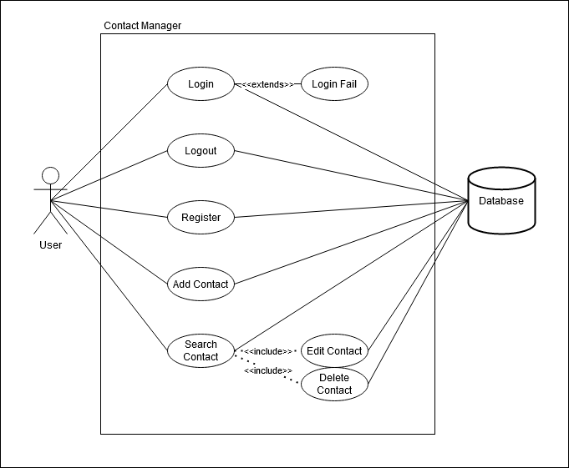
Use Case Diagram

Slide 7
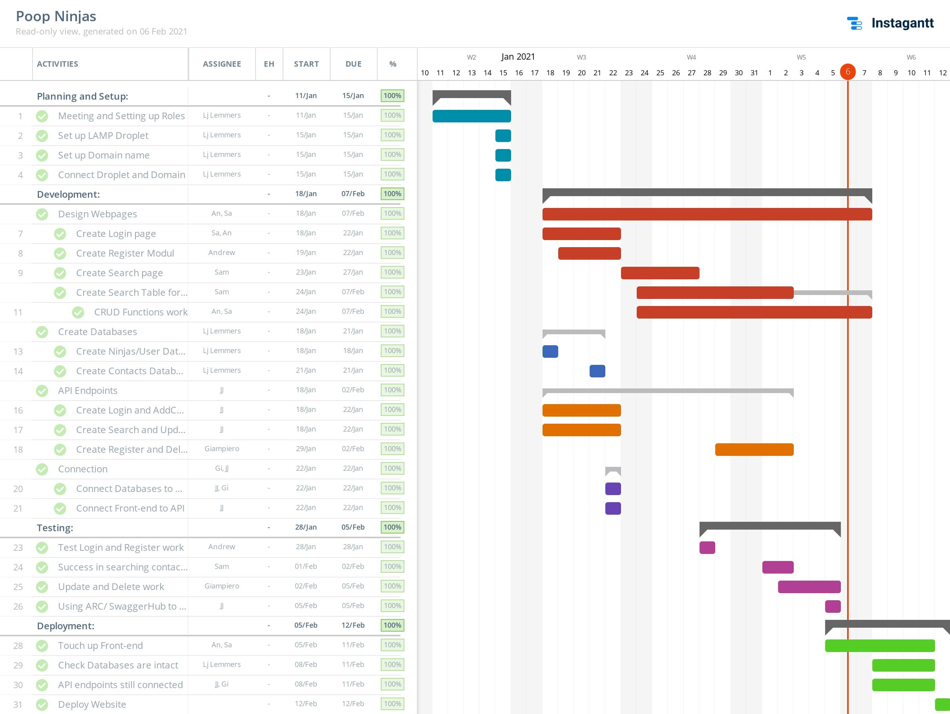
Gantt Diagram

Slide 8
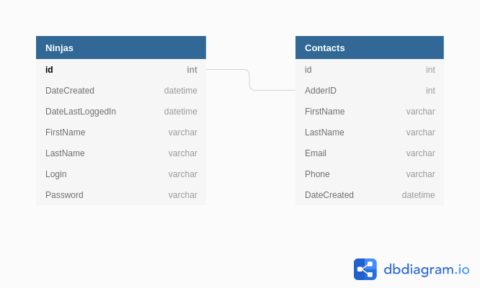
ERD Diagram

Slide 9

SwaggerHub Demo

Slide 10

Website Demo
www.poop21.ninja

Slide 11
Conclusion
Overall, our team had a great time working on www.poop21.ninja and despite the hardships, we all did our part and enjoyed our time working with each other.

Slide 12

Questions

